Slide 1
January 2010
J Moring
Overview of
Full Use WAVE Standards
IEEE 1609.3 and 1609.4

Slide 2
Introduction
This presentation provides an overview of the status of 1609 standards as of February 2010
  1609.3 and 1609.4
Agenda:
  Status of standards
  Overview of changes in d2.0/d3.0 from Trial Use
  Review of significant new features
    Service request processing
    Management data delivery
    Timing Advertisements
    WSMP extensions
    Message formats

Slide 3
Background
Trial Use WAVE standards published
1609.1-2006 Resource Manager
1609.2-2006 Security Services for Applications and Management Messages
1609.3-2007 Networking Services
1609.4-2006 Multi-channel Operation
Full Use standards in development
1609.0 Architecture
1609.1 Resource Manager
1609.2 Security Services for Applications and Management Messages
1609.3 Networking Services
1609.4 Multi-channel Operation
1609.5 Communications Manager (deferred indefinitely)
1609.11 Over-the-Air Data Exchange Protocol for Intelligent Transportation Systems (ITS) - Electronic Payment Service (proposed title)

Slide 4
Status
1609.0 Architecture (J Moring)
  Informative document; draft posted; expected date late 2010
1609.1 Resource Manager (A Malarky)
  Complete replacement of Trial Use functions; now includes logical identities, remote management functions, and timing info security; expected date mid to late 2010
1609.2 Security Services for Applications and Management Messages (W Whyte)
  Major update with some features deferred; expected date mid to late 2010
1609.3 Networking Services (J Moring)
  Major update; expected date mid 2010
1609.4 Multi-channel Operation (J Moring)
  Major update; expected date mid 2010
1609.11 Over-the-Air Data Exchange Protocol for Intelligent Transportation Systems (ITS) - Electronic Payment Service (D Sumida/J McNew)
  New standard; expected date mid to late 2010

Slide 5
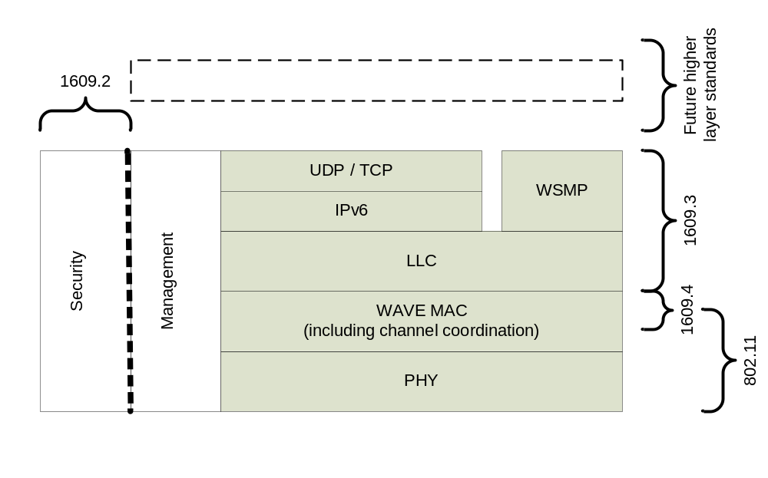
1609 standards

Slide 6
1609.3/1609.4 milestones
D2.0 published 2009/12/05
Balloting signup January 2010 (IEEE ballot group now open)
Working Group comment period ended 2010/1/14
  Proposed comment resolutions posted
D3.0 published 2009/1/31
Working Group sponsor ballot decision 2010/2/4
D3.x to IEEE for editorial review 2010/2/15
Sponsor ballot 2010/3/1 – 2010/4/30
  Allows time for one short recirculation
Documents published 2010/7/5
  Includes IEEE REVCOM, SASB

Slide 7
1609.3 Scope and Purpose
  Scope
The scope of this standard is to define services, operating at the network and transport layers, in support of wireless connectivity among vehicle-based devices, and between fixed roadside devices and vehicle-based devices using the 5.9 GHz DSRC/WAVE mode.
  Purpose
WAVE Networking Services represent layers 3 and 4 of the OSI communications stack. The purpose of this standard is to provide addressing and data delivery services within a WAVE system, providing multiple higher layer entities access to WAVE communication services. Upper layer support includes in-vehicle applications offering safety and convenience to their users.

Slide 8
1609.4 Scope and Purpose
  Scope
This standard describes multi-channel wireless radio operations outside the context of a basis service set, medium access control (MAC), including the operation of control channel (CCH) and service channel (SCH) interval timing, parameters for priority access, channel switching and routing, management services, and primitives designed for multi-channel operation.
  Purpose
To enable effective mechanisms that control the operation of upper layer data transfers across multiple channels, without requiring knowledge of PHY parameters, and describe the multi-channel operation channel routing and switching for different scenarios.

Slide 9
Agenda
Status of standards
Overview of changes in d2.0/d3.0 from Trial Use
Review of significant new features
  Service request processing
  Management data delivery
  Timing Advertisements
  WSMP extensions
  Message formats

Slide 10
What hasn’t changed from Trial Use
General Control Channel (CCH) and Service Channel (SCH) functions and timing
Use of service advertisements (WSAs) to indicate SCH availability
Use of WSMP, IPv6, and LLC
Use of service and packet prioritization

Slide 11
Major changes from Trial to Full Use 1609.3/1609.4
Aligned with 802.11p Sponsor Ballot version
  Including different Timing Advertisement frame, no unique WSA frame
Rework of the service request, scheduling and access processes for more flexibility
  More flexible options for channel switching (and not switching), e.g., immediate and extended access
  Changes in terms: no “WBSS,” “persistence,” “joining,” or “registration”
Clearer specification of minimal compliant implementation
WSA carried in Vendor Specific Action (VSA) frame
  Unsigned WSA option
Added optional extension fields in WSA and WSM header for flexibility, capability, and growth
Include support of other regulatory domains, e.g., Country info element
Little or no specification of requirements by RSU/OBU device type
  Removed specification of RSU backside distribution system
Support generic management data transfer via VSAs
Support for Timing Advertisement (TA) frame and functions
Added WSMP Safety extension protocol (1609.3 Annex G), and support for other extensions
Added primitives for address change to support anonymity/pseudonymity
More explicit security call (for advertisement signing & verification) via new 1609.2 SAPs

Slide 12
Rationale for changes
CHANGE | RATIONALE
Aligned with 802.11p | Consistency
Rework of the service requests | Allow more flexible implementations
Specification of minimal compliance | Preparation for certification
WSA carried in VSA frame | Loss of WSA frame in 802.11p; most suitable vehicle for WSA. TA may be used in the future.
Optional extension fields in WSM and WSA | Flexibility and future-proofing
Other regulatory domains | Allows operation outside USA
No spec of requirements by RSU/OBU type | Remove unnecessary constraints; allow other device types
Support generic management data transfer | Request from A Malarky/MarkIV/1609.1 for remote device configuration
Support for Timing Advertisement | 802.11p feature felt needed by 1609 group for synchronization; may expand in the future
Added WSMP Safety extension protocol | Request from J Kenney/Toyota; also supports addressing features in 1609.1
Added primitives for address change | Feature felt needed by 1609 group for minimal anonymity capability; may expand in the future
Security SAPs | Clarifies security processing

Slide 13
Agenda
Status of standards
Overview of changes in d2.0/d3.0 from Trial Use
Review of significant new features
  Service request processing
  Management data delivery
  Timing Advertisements
  WSMP extensions
  Message formats

Slide 14
Service requests in 1609.3
We previously had the concept of applications registering for service (provider/user), with the service subsequently becoming active based on strict rules
Now WME accepts service requests of several types from higher layer entities, and runs an unspecified scheduling algorithm to assign channel access
  Requests still stored in MIB
  Requests are more flexible, e.g., many possible parameters to match in User Service Request

Slide 15
Service request types
Service Request Type | Primary Purpose | Channel/interval assignment | Message Generation
Provider | Service advertisement/ SCH participation | CCH in CCH interval and SCH in SCH interval; or continuous SCH access | VSA frame containing WSA on CCH
User | Service availability notification/ SCH participation | SCH in SCH interval, plus optionally SCH in CCH interval | none
WSM | Received message delivery | none | none
CCH | Control channel participation | CCH in CCH or SCH interval or both | none
Management data | Management data distribution | CCH or SCH; CCH or SCH interval or both | VSA frame with external data
Timing advertisement | Time distribution | CCH or SCH; CCH or SCH interval or both | TA frame

Slide 16
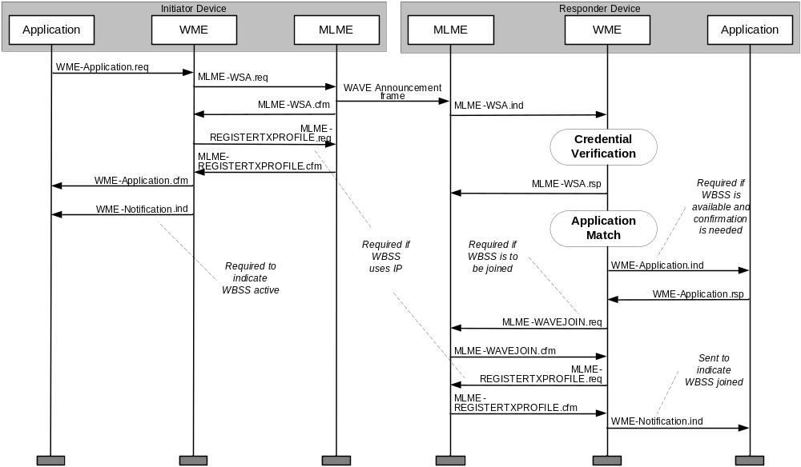
Old flow

Slide 17
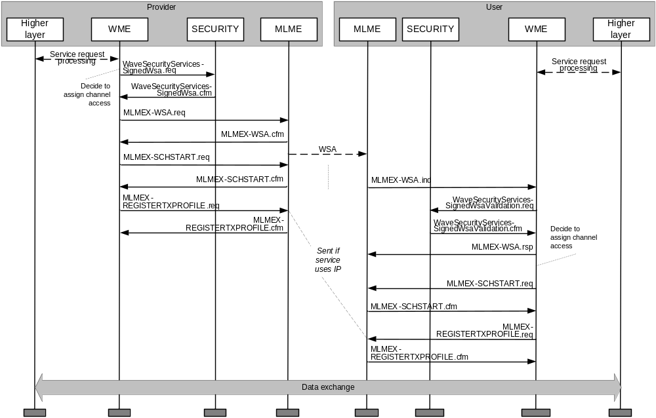
Current flow

Slide 18
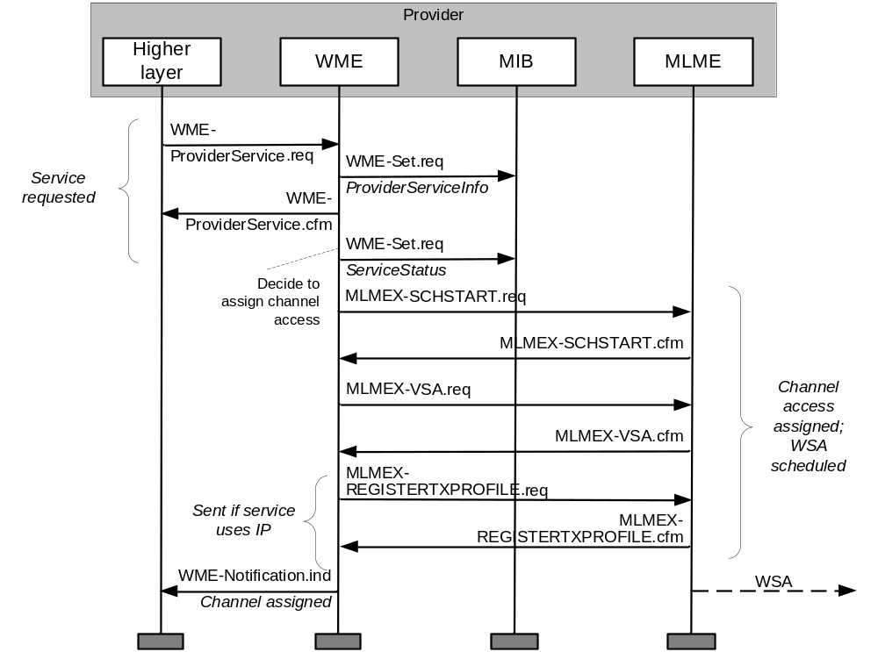
Example: provider service (Annex E)

Slide 19
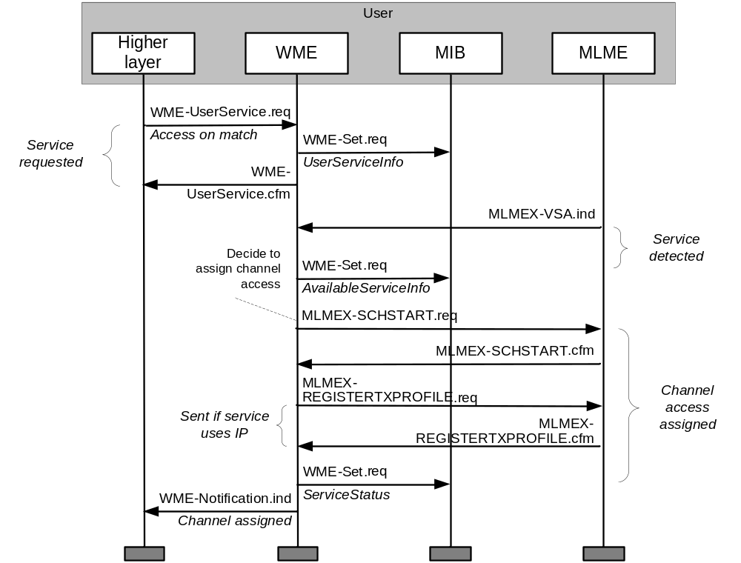
Example: user service request with automatic channel assignment

Slide 20
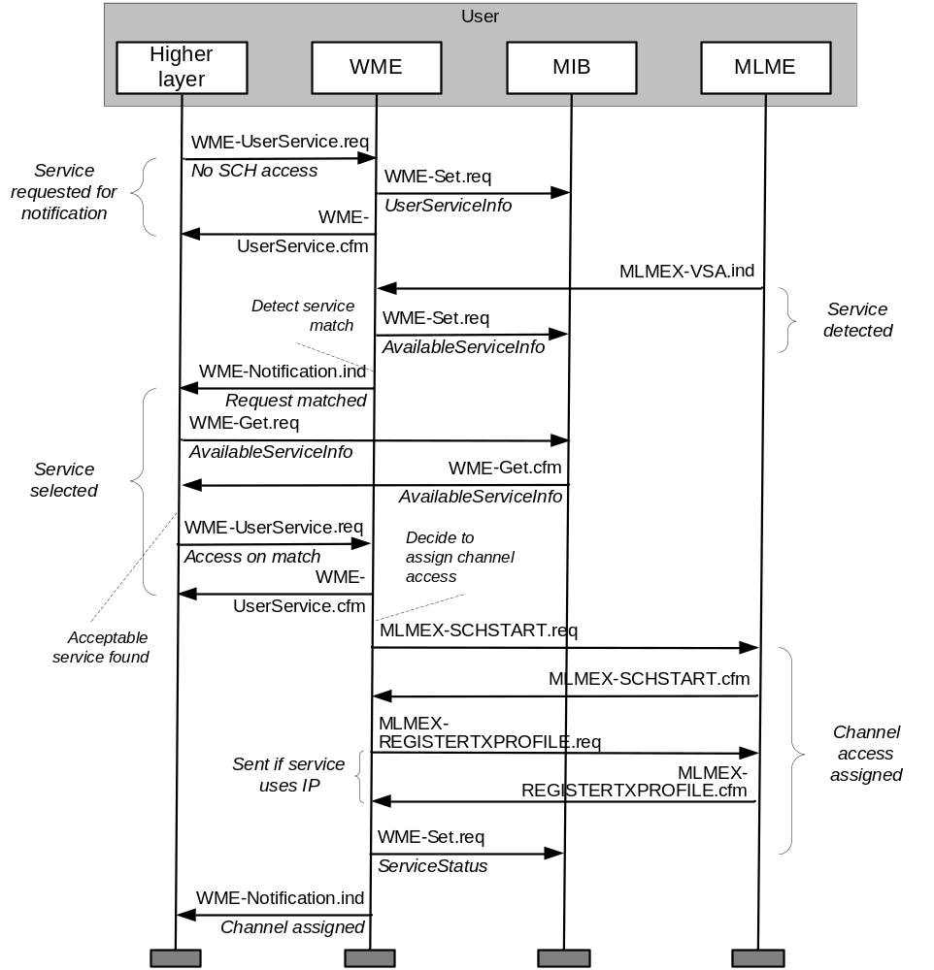
Example: user service request with notification
This replaces confirm-before-join

Slide 21
Agenda
Status of standards
Overview of changes in d2.0/d3.0 from Trial Use
Review of significant new features
  Service request processing
  Management data delivery
  Timing Advertisements
  WSMP extensions
  Message formats

Slide 22
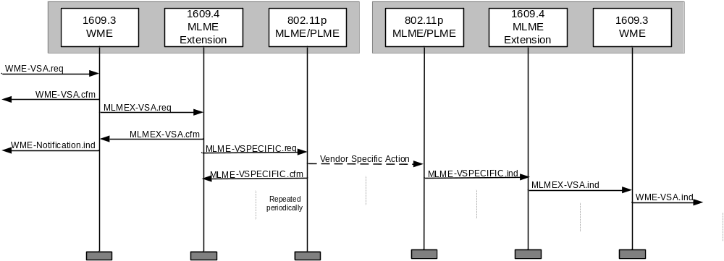
Sending general management data
Management data is accepted from external management entities
Delivered in VSA frames
Delivered to peer recipient by Management ID

Slide 23
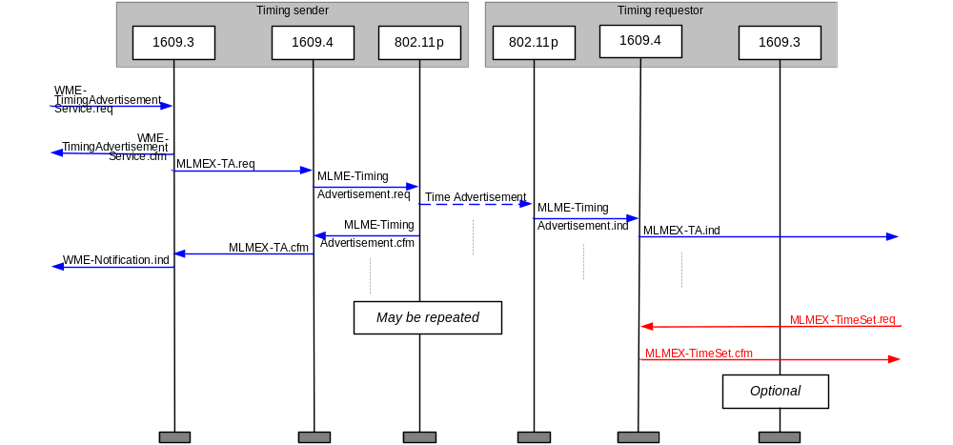
Sending Time Advertisements for clock alignment
Timing distribution triggered by external entity
Timing info may be used by 1609.4 or external entity

Slide 24
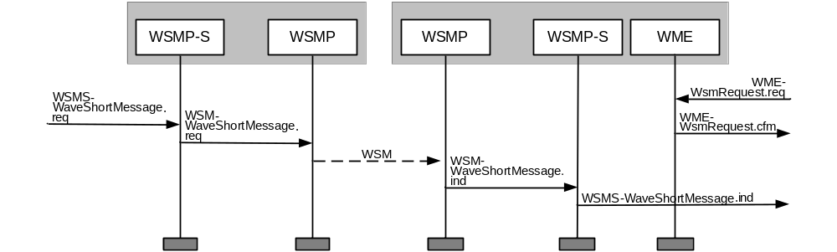
Support for WSMP Extensions
External entity delivers short message data to new processing entity
  Here WSMP-S specified in 1609.3 Annex G
After any processing, transferred via normal WSMP
Data is delivered on receipt to peer processing entity (based on Management ID) and finally to the recipient higher layer (based on PSID)

Slide 25
Agenda
Status of standards
Overview of changes in d2.0/d3.0 from Trial Use
Review of significant new features
  Service request processing
  Management data delivery
  Timing Advertisements
  WSMP extensions
  Message formats

Slide 26
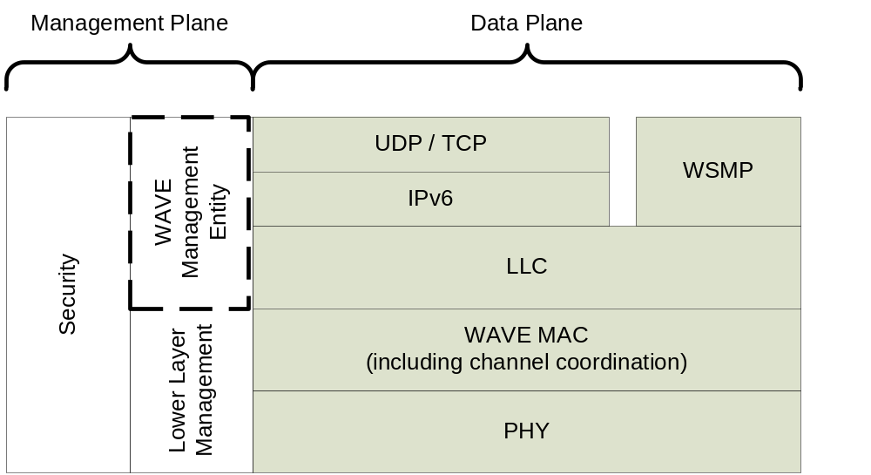
Protocols
Data Frames
(WSMP, IP)
Management Frames
(VSA, TA, other)

Slide 27
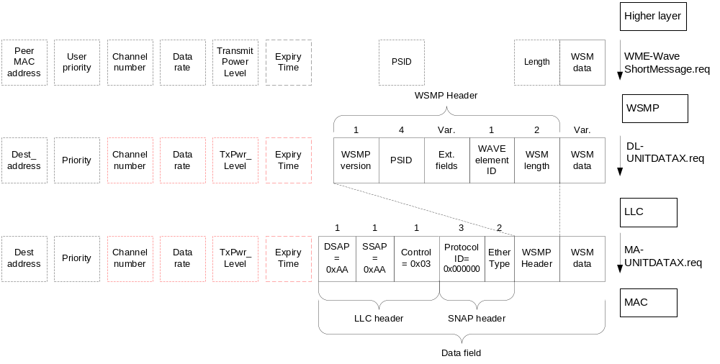
WSMP format
Red lines indicate WAVE extensions
Dotted lines indicate local control info
Shading indicates optional

Slide 28
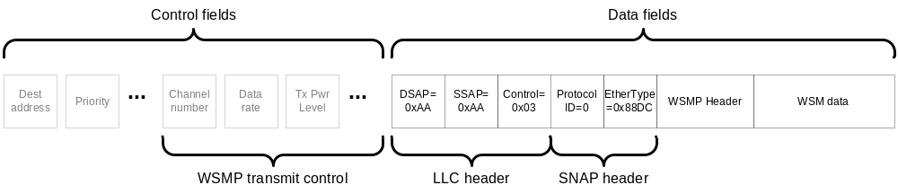
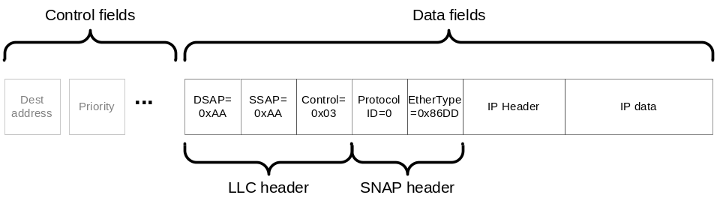
LLC/SNAP
Ethernet Type 0x88DC WSMP
Ethernet Type 0x86DD IPv6
LLC not used for management frames
Data passed to the MAC:

Slide 29
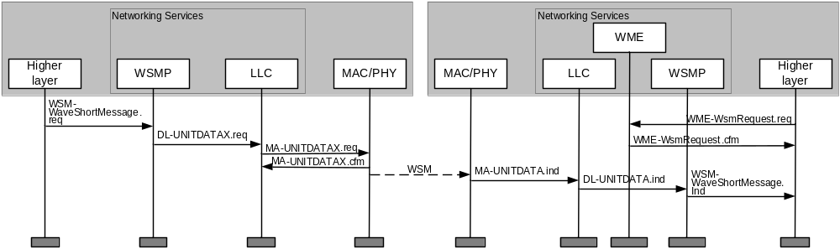
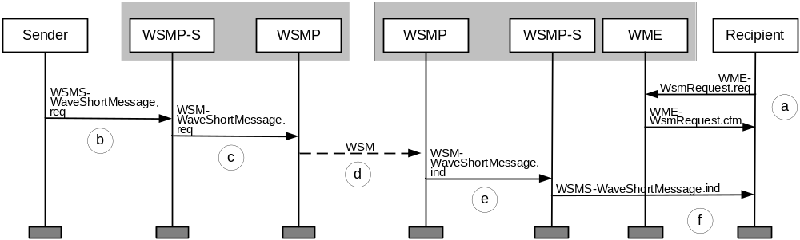
New support for WSMP sublayers, e.g., WSMP-S Annex G
WSMs are generally delivered by PSID on receipt
Now allow interim delivery by Element ID to sublayer (step e)

Slide 30
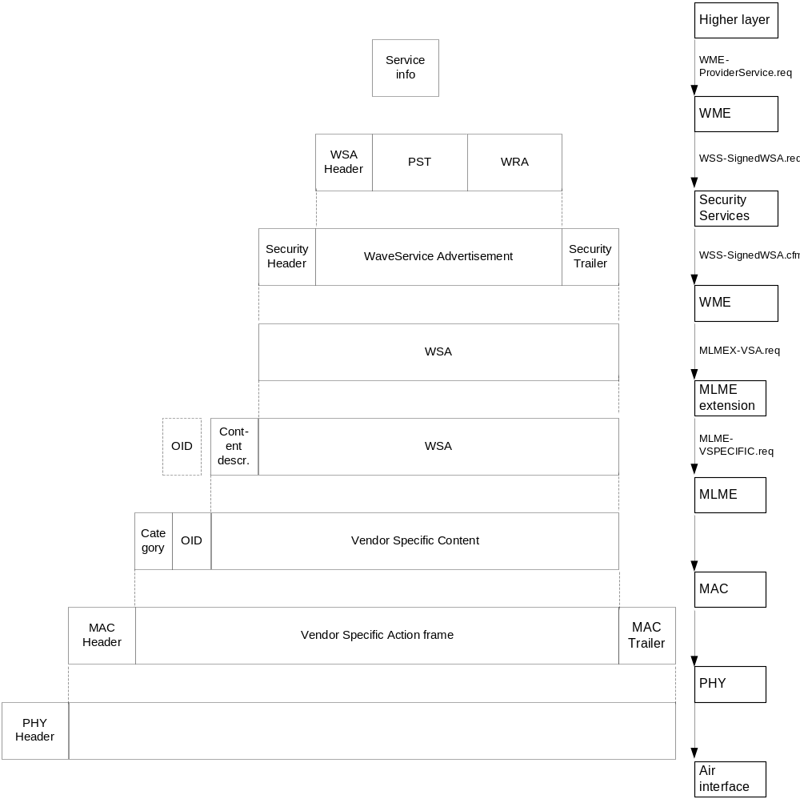
WSA resides in the 802.11p Vendor Specific Action management frame

Slide 31
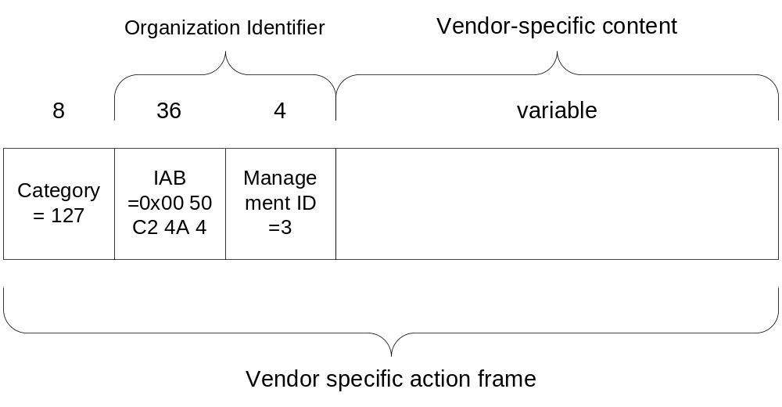
VSA frame per 802.11/802.11p/1609.4/1609.0

Slide 32
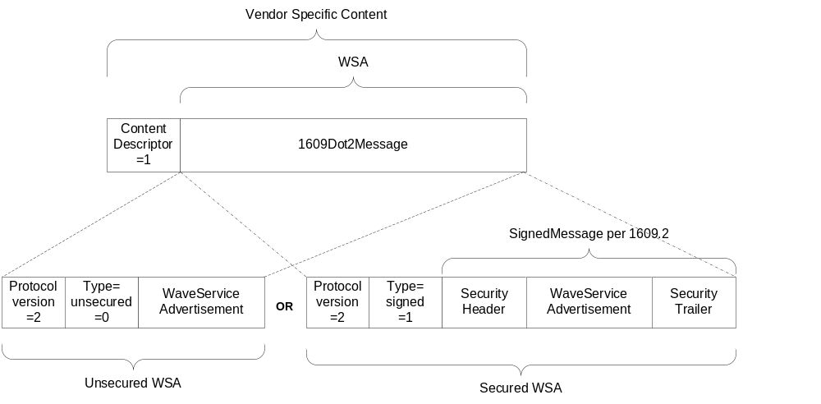
WSA format, per 1609.3/1609.2

Slide 33
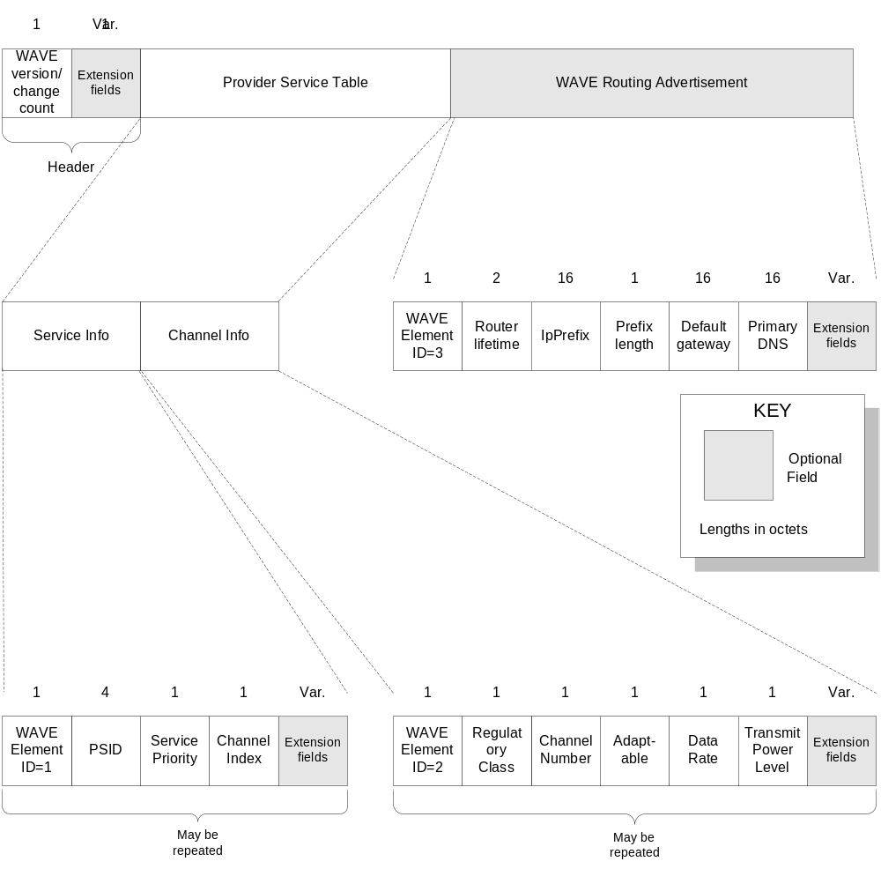
WAVE Service Advertisement, per 1609.3

